Slide 1
Cleaning Week 4

Slide 2
In pairs
1.10.1976
5/4/2020
1678-30-01
04-07-2023
Dec, 1, 1849
What are we looking at? Why does it matter?
Address the problem together. Document in DETAIL each step to doing so.
Notes:
Actual job interview question!

Slide 3
What is cleaning?
What is cleaning in their own lives?
What are different ways to clean?
What were take aways from the podcast episode?
Why do it?

Slide 4
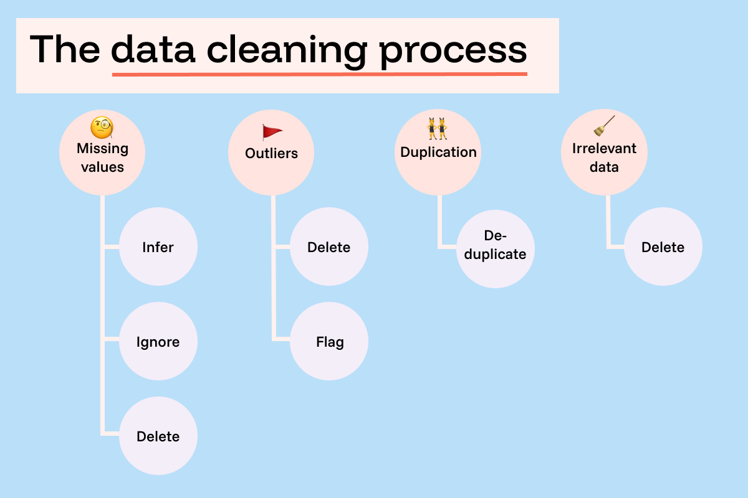
Notes:
https://funnel.io/blog/what-is-data-cleaning-your-complete-guide

Slide 5
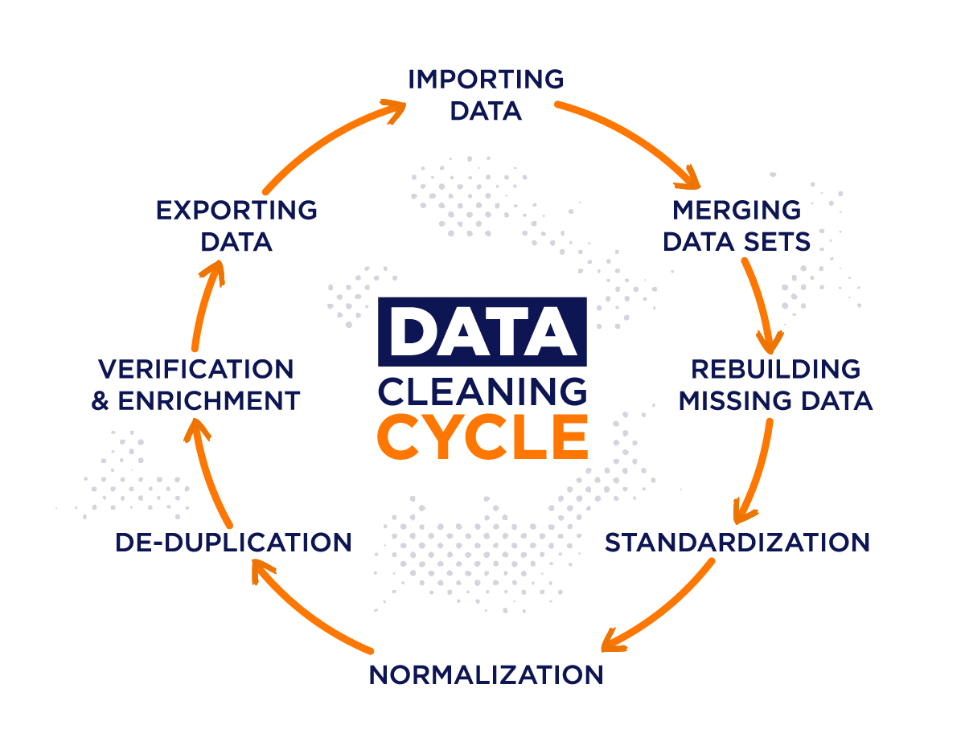
Notes:
From https://airbyte.com/data-engineering-resources/data-cleansing

Slide 6
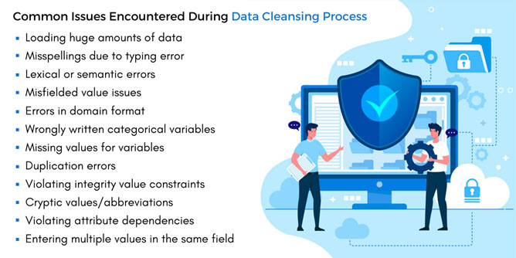
Notes:
https://www.markovml.com/blog/automated-data-cleaning

Slide 7
5 characteristics of quality data
Validity. The degree to which your data conforms to defined business rules or constraints.
Accuracy. Ensure your data is close to the true values.
Completeness. The degree to which all required data is known.
Consistency. Ensure your data is consistent within the same dataset and/or across multiple data sets.
Uniformity. The degree to which the data is specified using the same unit of measure.
Notes:
https://www.tableau.com/learn/articles/what-is-data-cleaning

Slide 8
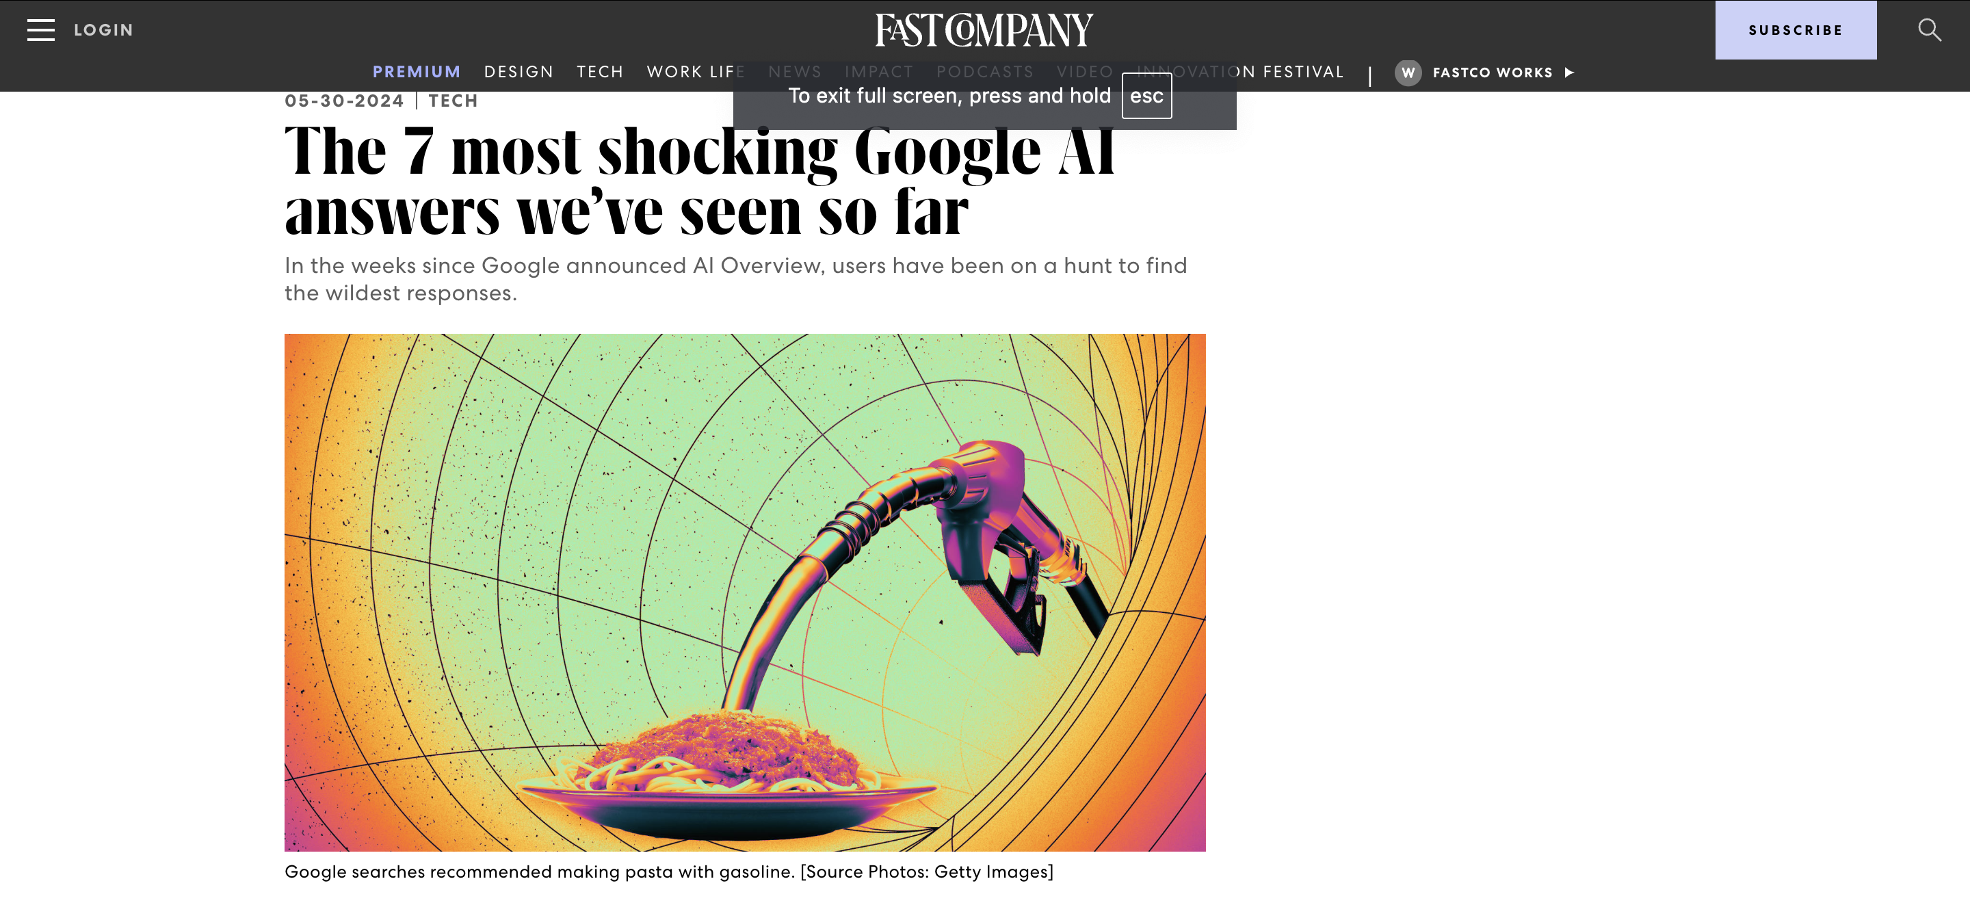
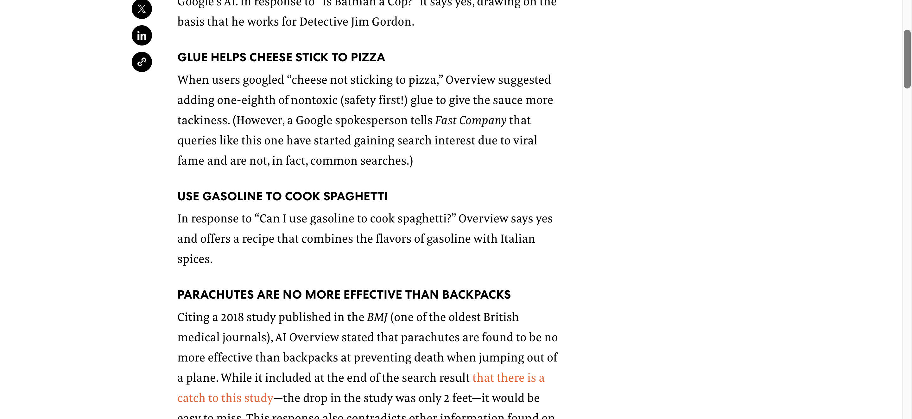
Why Clean
Ensures your analysis is correct
In some cases, actually lets you do it in the first place!
Stay off the front page of the news

Slide 9
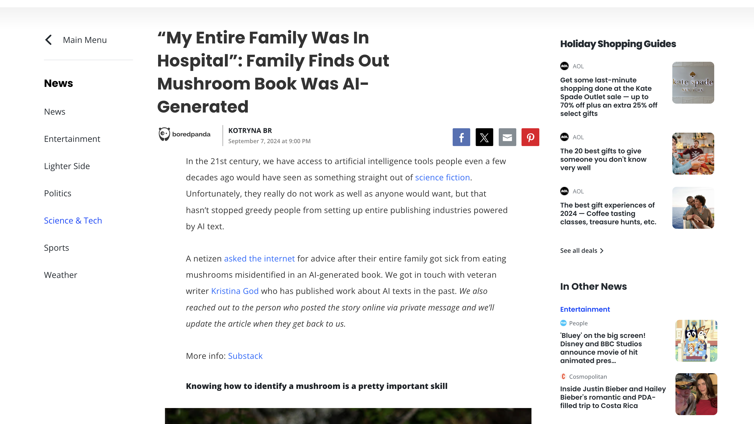
Notes:
Also saves lives

Slide 10
Why Not Clean?
Eliminating difference
Exerting authority over the data (what if they are people?)
“Messy” and “Clean” imply an order that might not exist in life
Perfect might be the enemy of the good

Slide 11
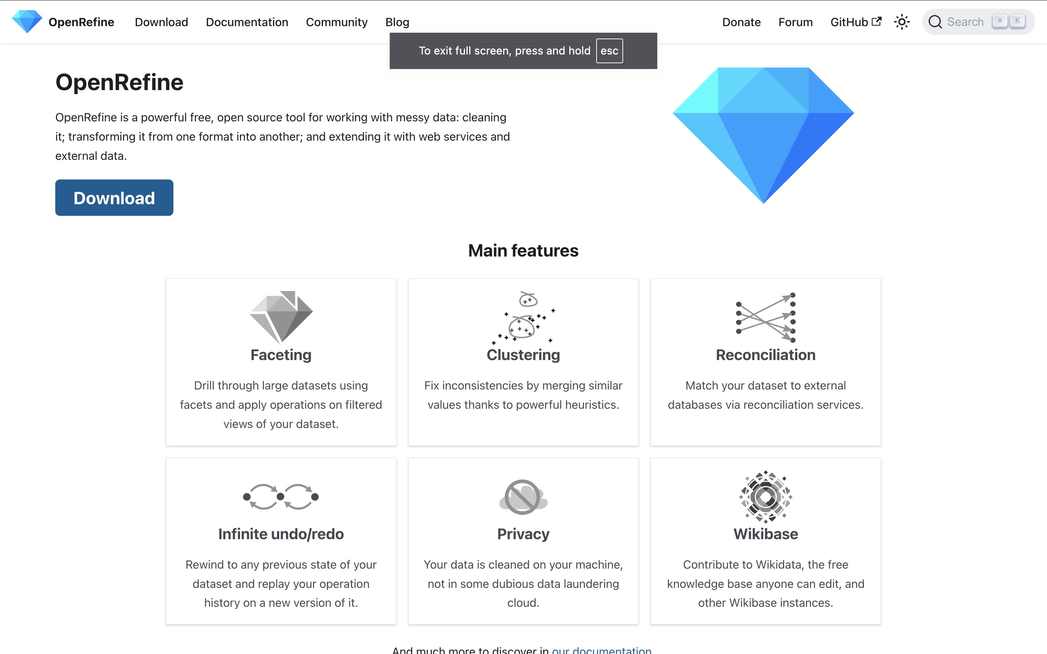
Open Refine Workshop

Slide 12
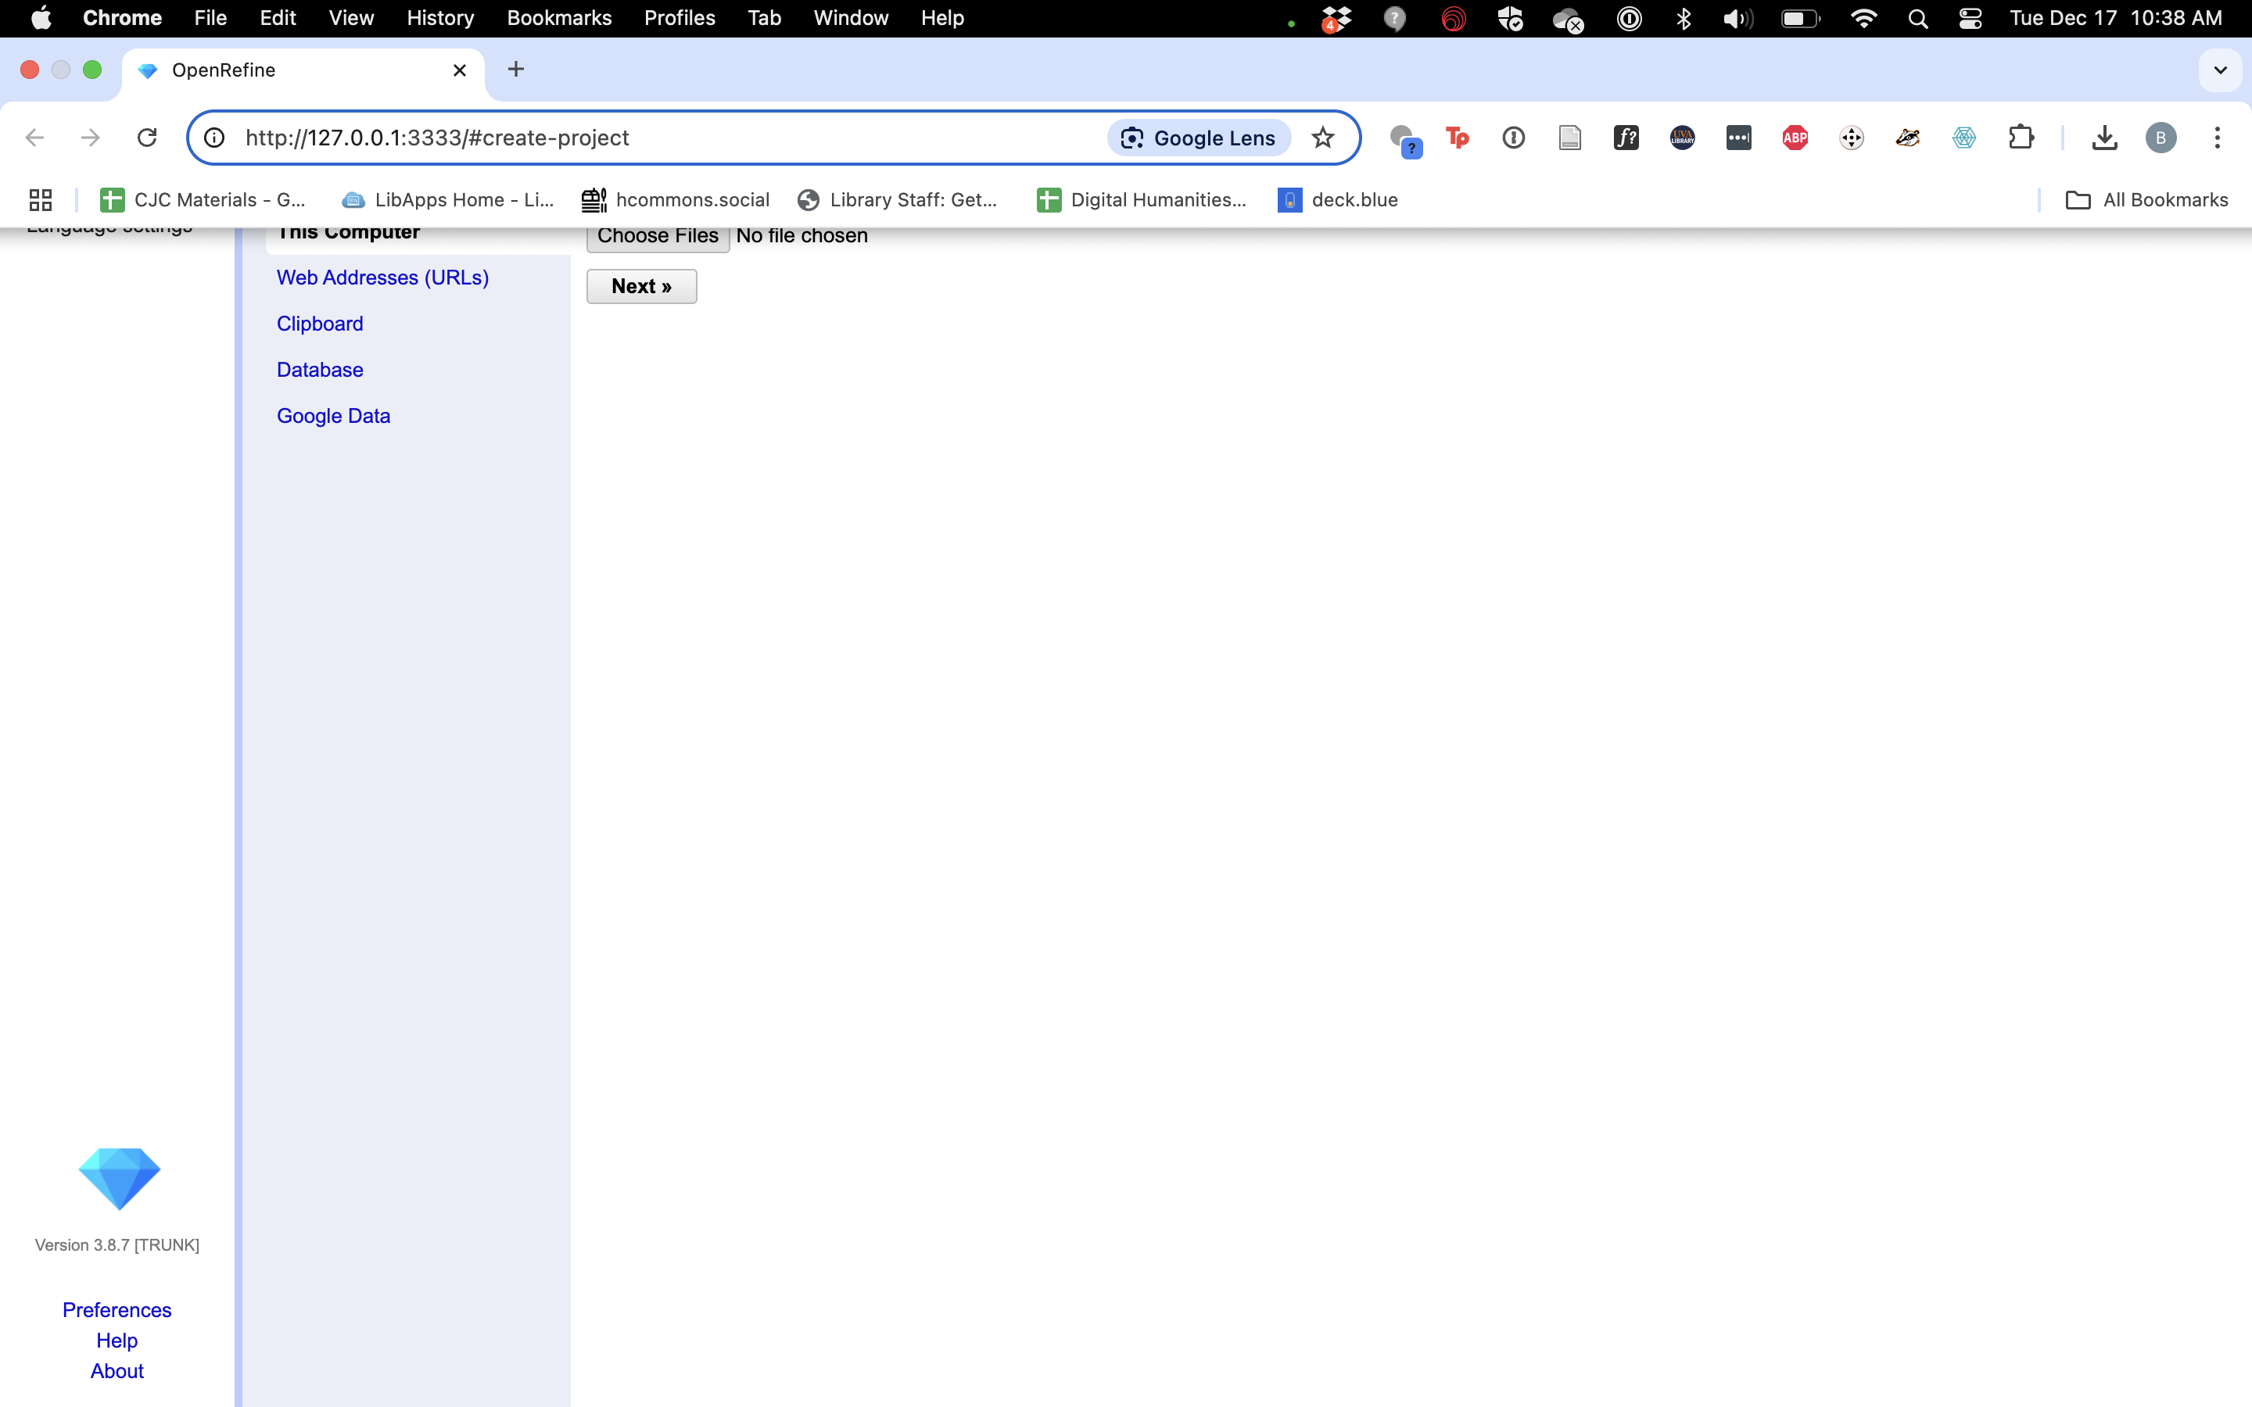
Before Session
Visit https://bit.ly/D4US-audible and download both the uncleaned version and the cleaned one.
Scroll down and select them under “data explorer”
Then click the download button at left for each
You’ll be asked to make an account
Download and install OpenRefine
Once you open it you should see OR launch in a browser window
Note the URL

Slide 13
Setup
When you launch OpenRevine it opens in a browser window
Note the URL

Slide 14
Setup
When you launch OpenRevine it opens in a browser window
Note the URL
Choose the uncleaned audible file to upload

Slide 15
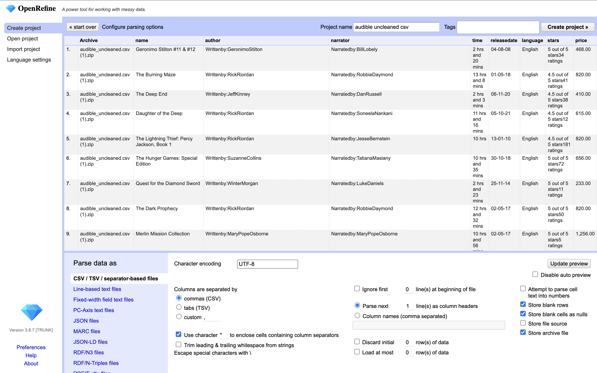
Interface
Data at top
Parsing Info at bottom
This is where you would make a lot of decisions about how to import your data like…
Language
Formatting
Create the project

Slide 16
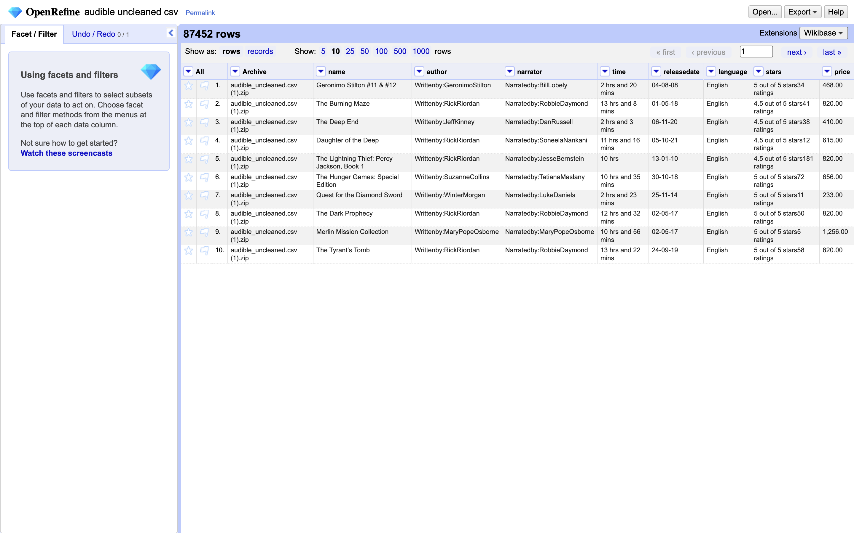
Interface

Slide 17
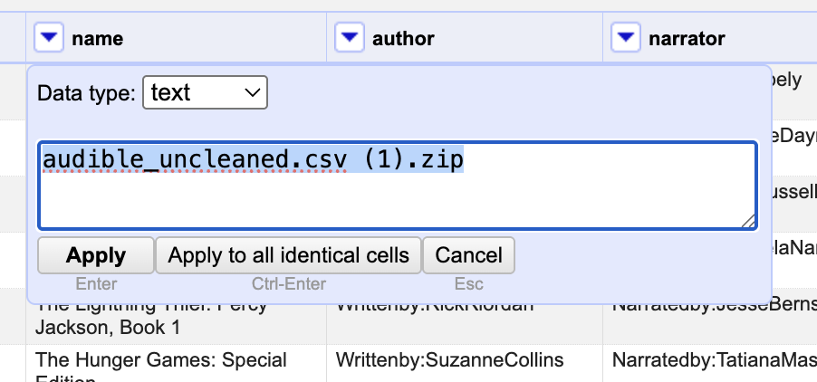
Edits
Hover over a cell.
Clicking edit lets you affect either one cell or every similar cell
Let’s modify this column to just be “audible_uncleaned”
Change the text and apply to all

Slide 18
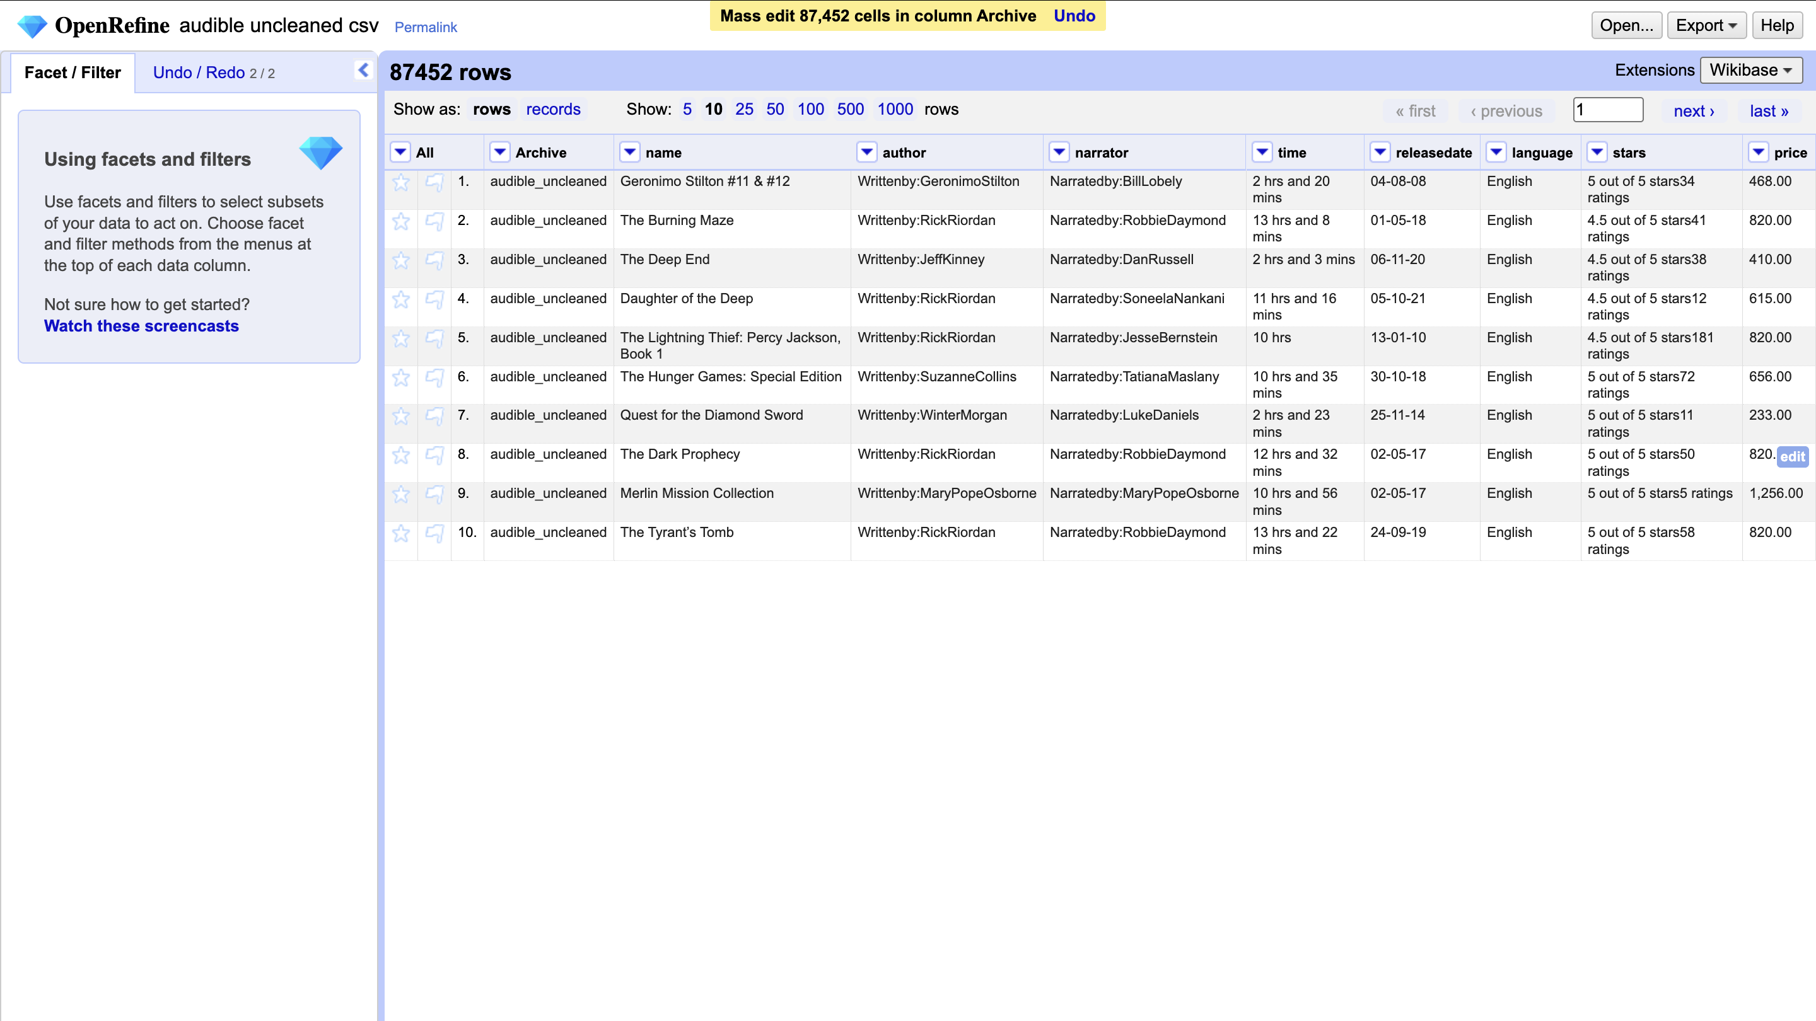
Notes:
Sit with that magic for a second

Slide 19
Repeat
Massage out the following fields:
Author
Narrator

Slide 20
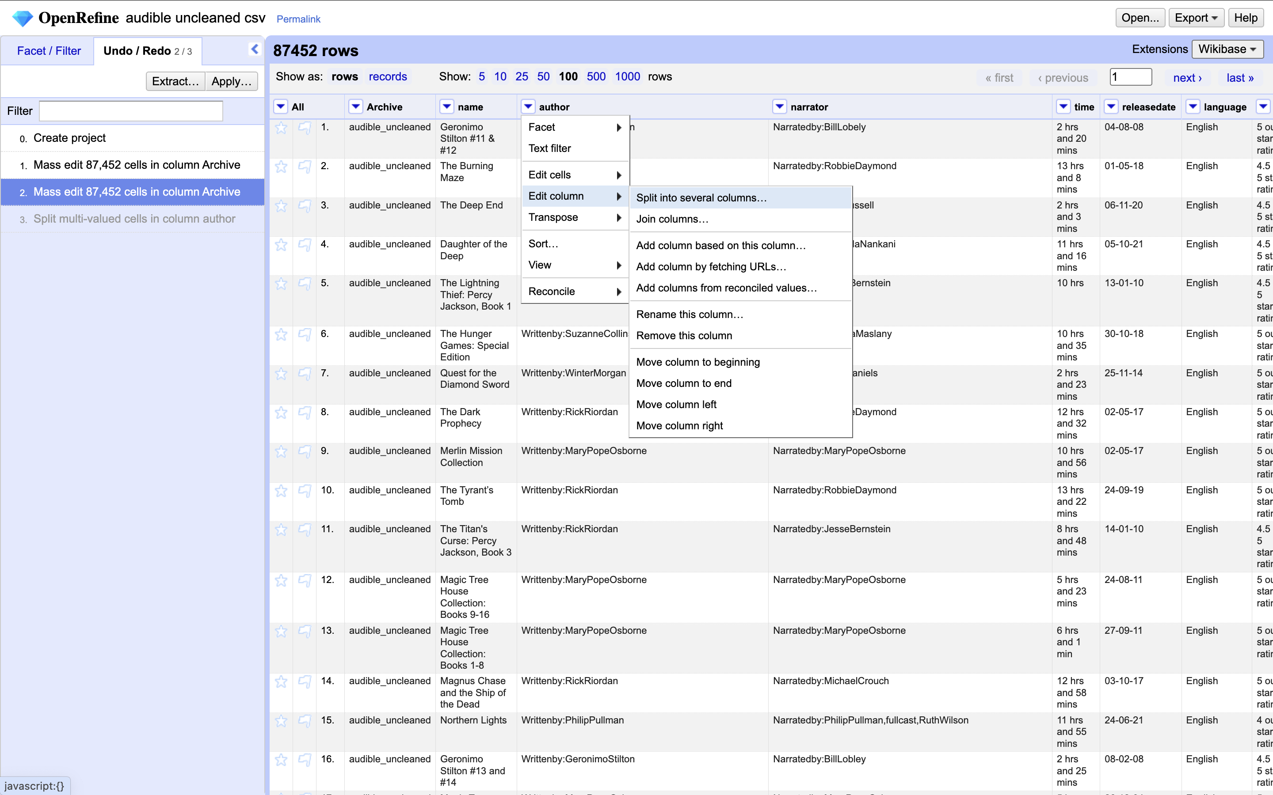
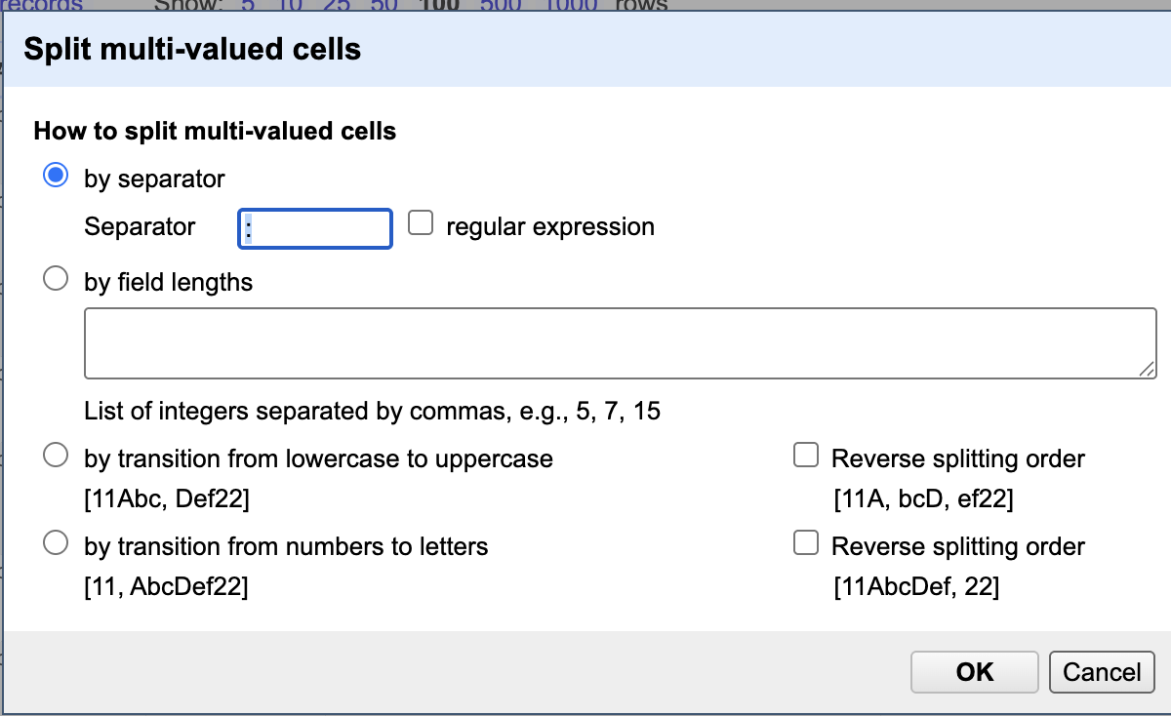
Splitting and Undoing
Try to edit the author field.
Did it work?
Try a couple more mass edits of that column.
Another thing we can do is split the data into columns and delete that way.
Did that work?
If not, explore the undo menu and try again

Slide 21
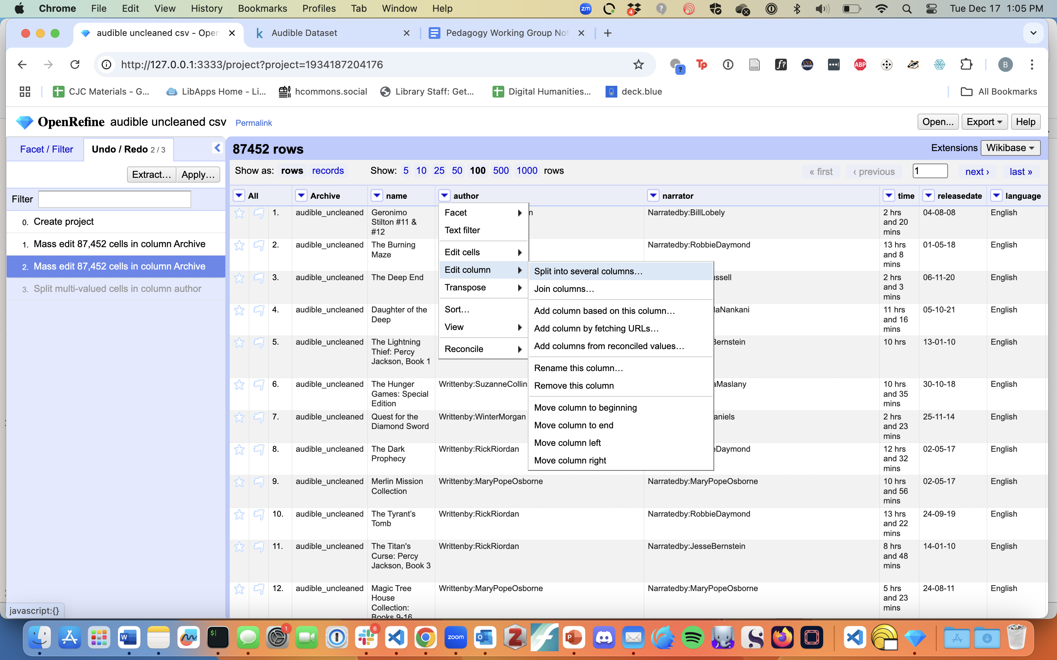
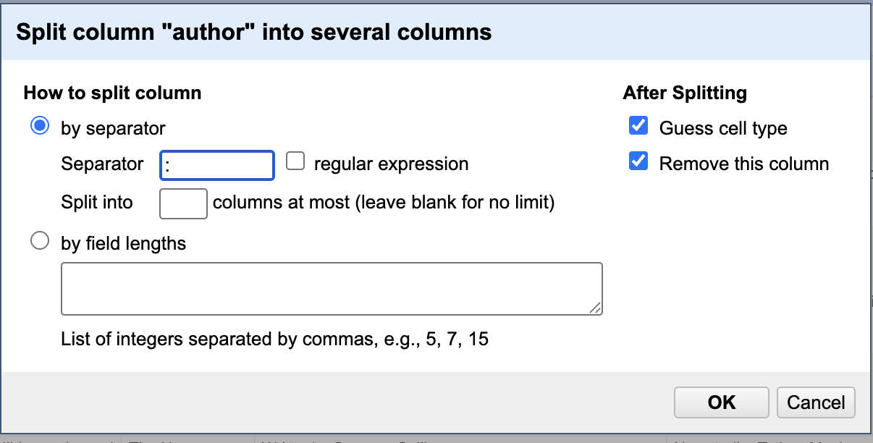
Cleaning Up
Delete the Extra Column
Arrow dropdown -> edit column -> remove column
Do the same thing with narrator column
Split, remove it
That leaves us with two columns named author 2 and narrator 2
Use the edit column function to rename them
Now we have names – can you use the same function to separate first and last names?

Slide 22
Now You Try
Split stars and ratings into separate categories
Rename them “stars” and “ratings”
Can you make sure they’re both just numbers?
Hint: use the split function on the ratings column

Slide 23
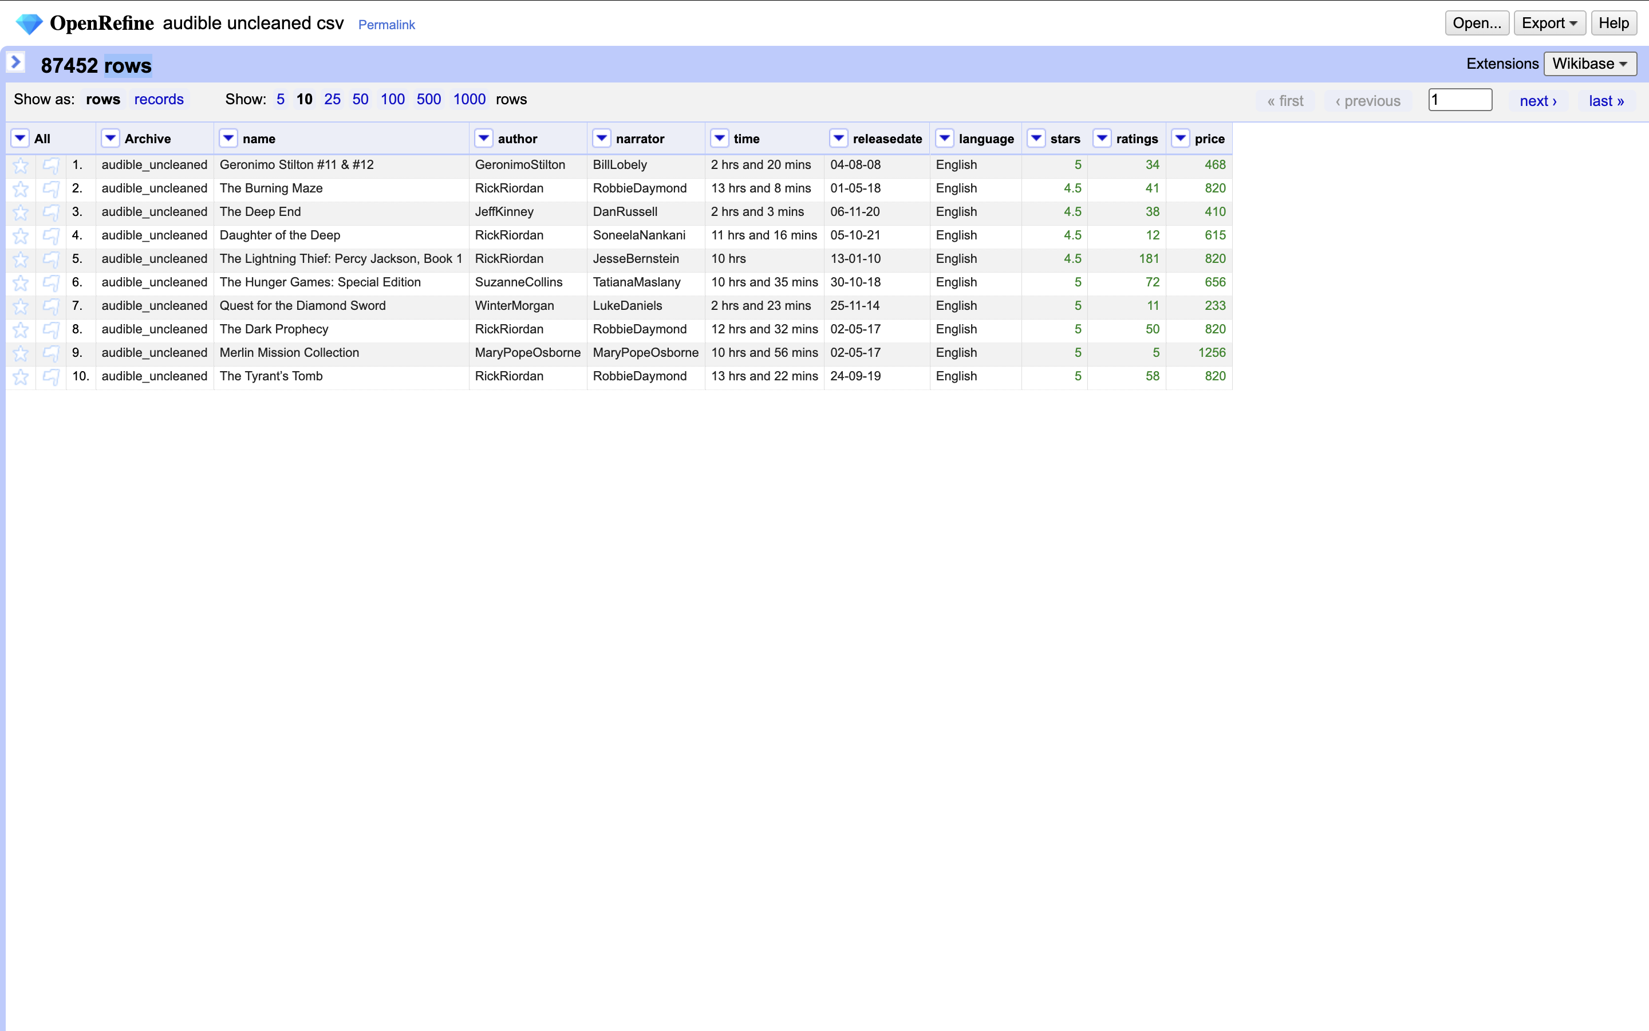
Custom Text Transformations
Eliminate trailing zeros for price
Edit cells -> transformation
Can modify the “value” there
value[0,-3]
Index numbers for each digit -> says “start” to three from the end
Removes our zeroes!
Any problems with that?
Use a custom transform
value.replace(“,”,””)
Says “replace each comma with nothing
Now use a common transformation to turn it all into numbers

Slide 24
Time
Lets condense hours + minutes into just minutes
Split the column according to spaces
Rename the ones we care about
Remove the columns we don’t want
We should be left with just an hours column and a minutes column
Minutes column will have some blanks in it – edit one to be 0, change to number type, and apply to all

Slide 25
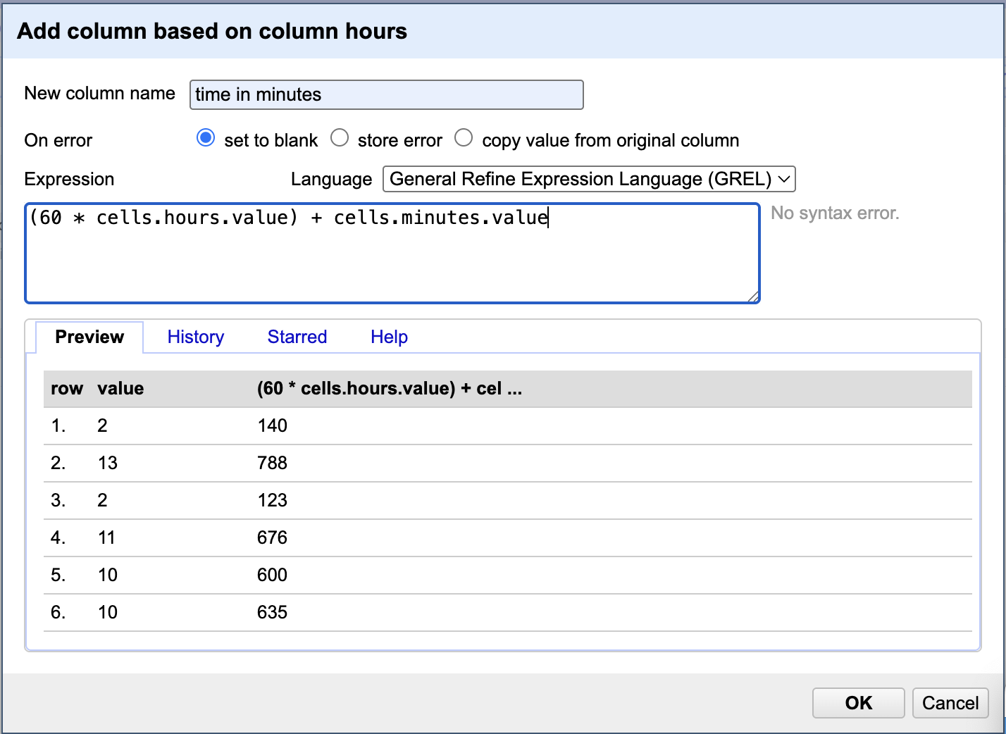
Time cont.
Click on hours dropdown -> add column based on this value
Enter values at right
(60 * cells.hours.value) + cells.minutes.value
Convert hours to minutes and hours and minutes
If we pay attention, that didn’t quite grab all errors
We can look into it by using the sort menu to float blank and error categories to the top

Slide 26
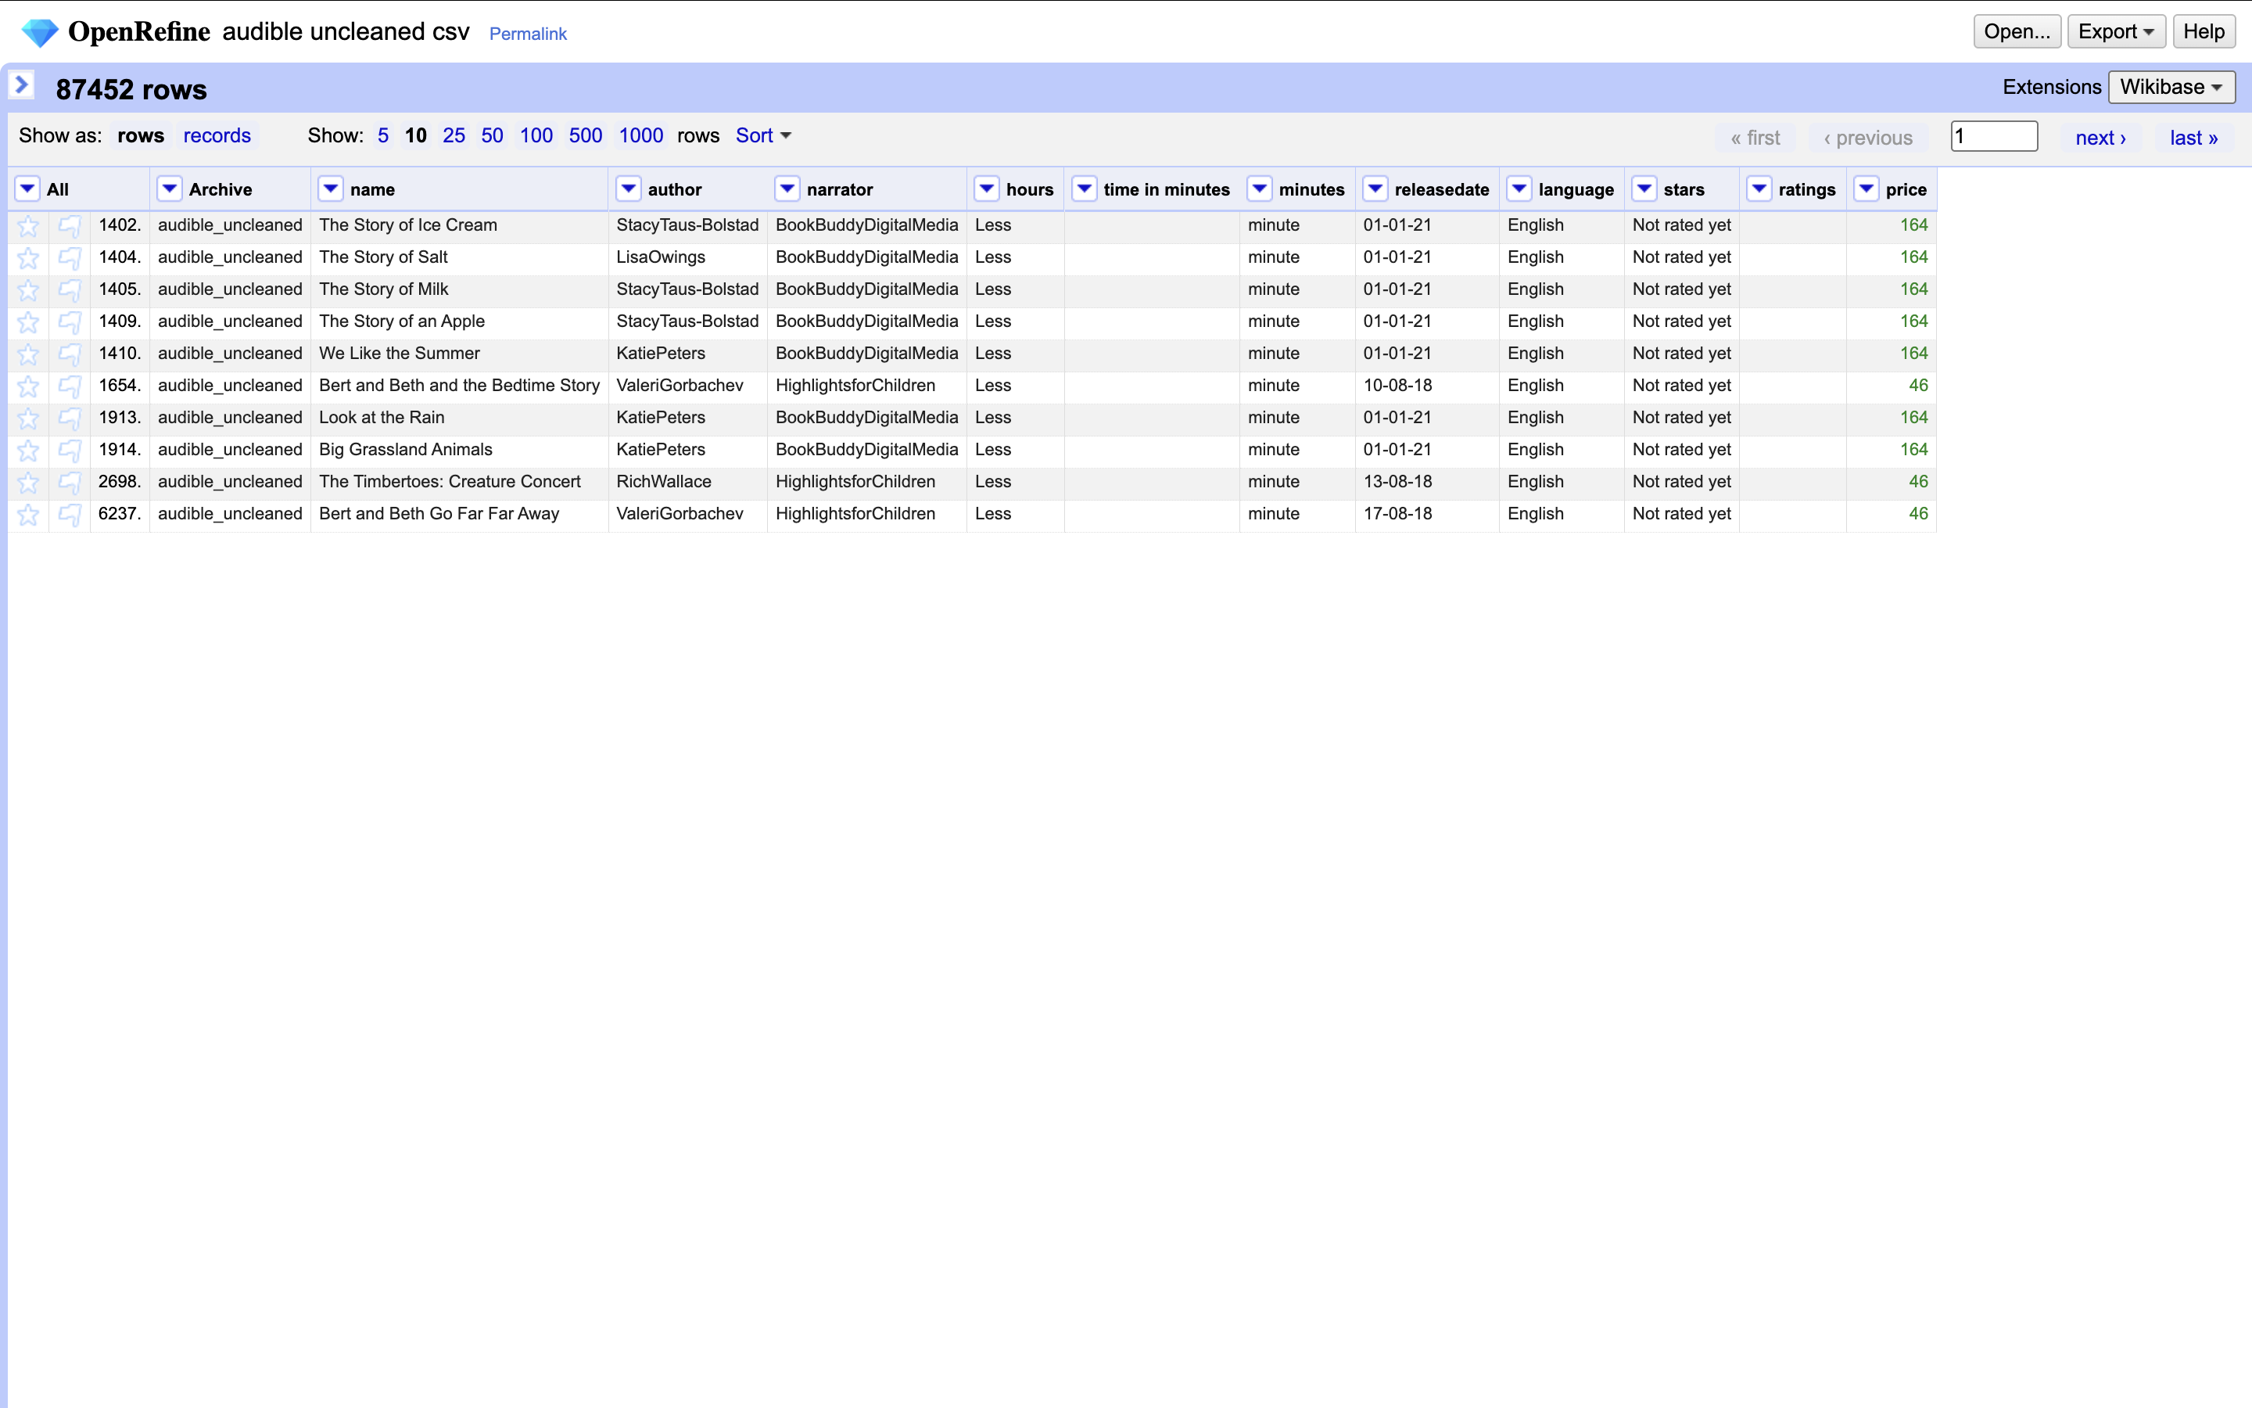
Errors
Lots of issues!
What do you notice?
If we had more time we could work on massaging these out and catching errors
But what did we learn?
No substitute for the human eye
Important to look at the data!
We can see that some audiobooks are less than one hour - didn’t count on that

Slide 27
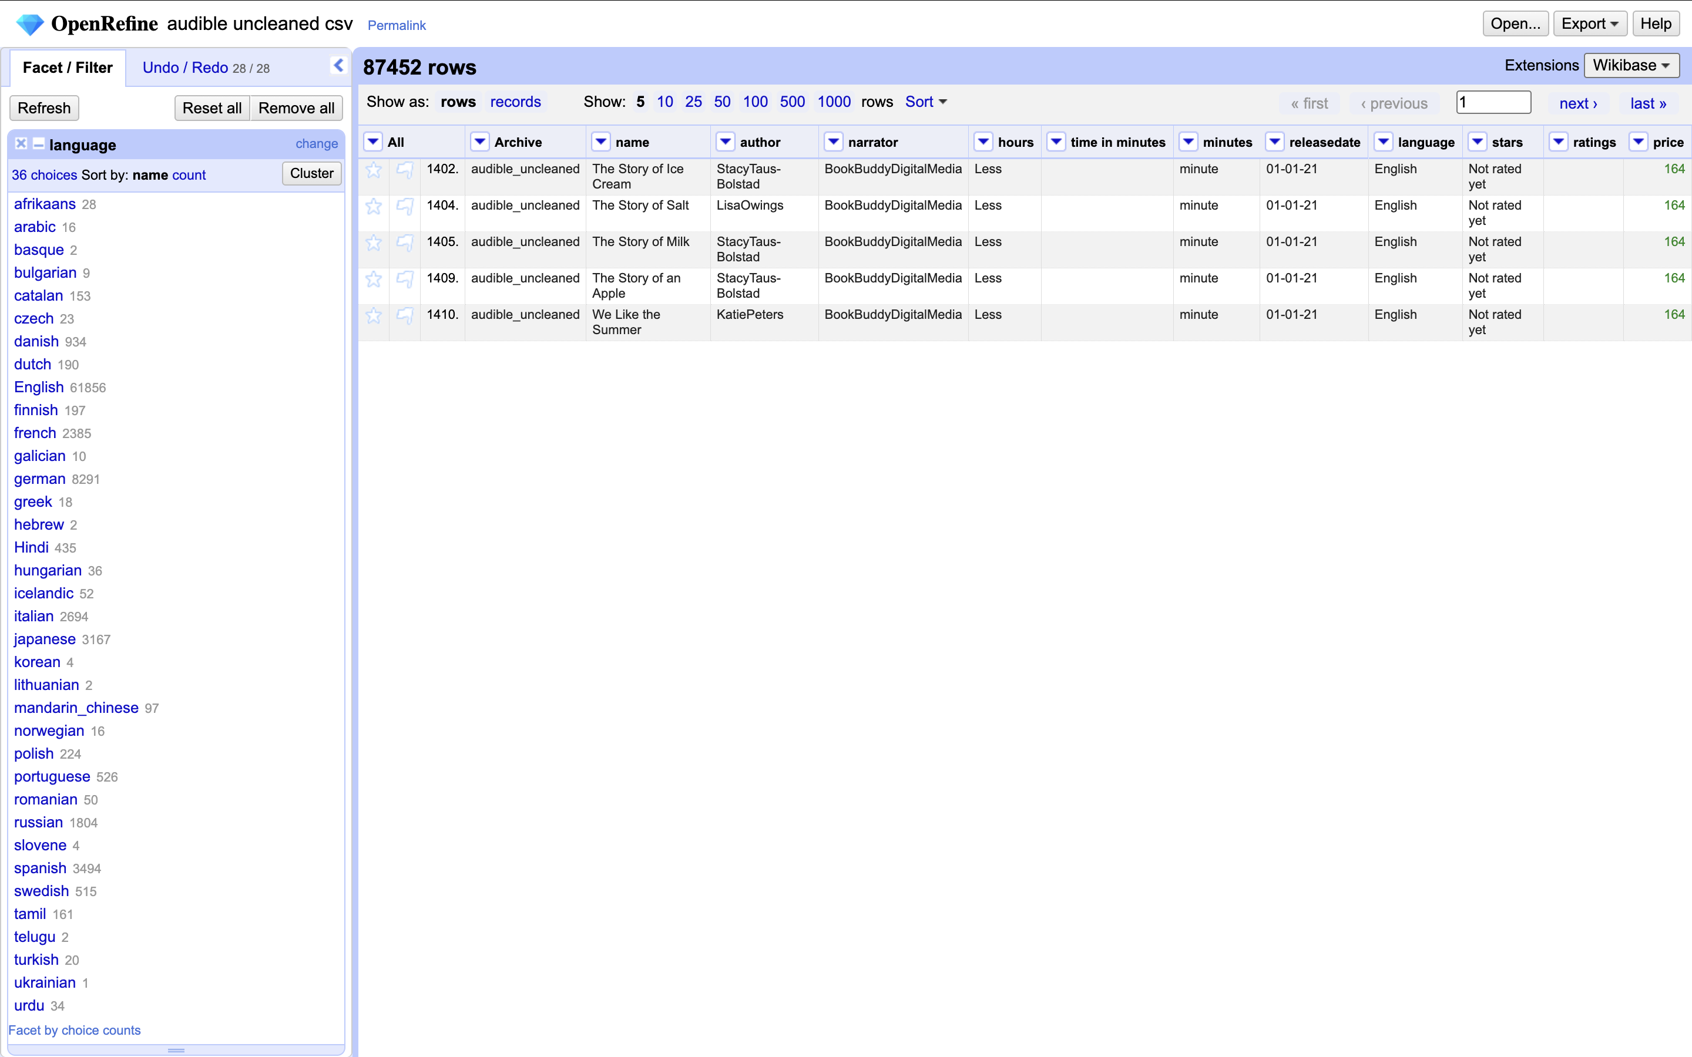
Facets
Give you information about your data
Language dropdown -> facet -> text facet
Gives you a quick and dirty count of your values

Slide 28
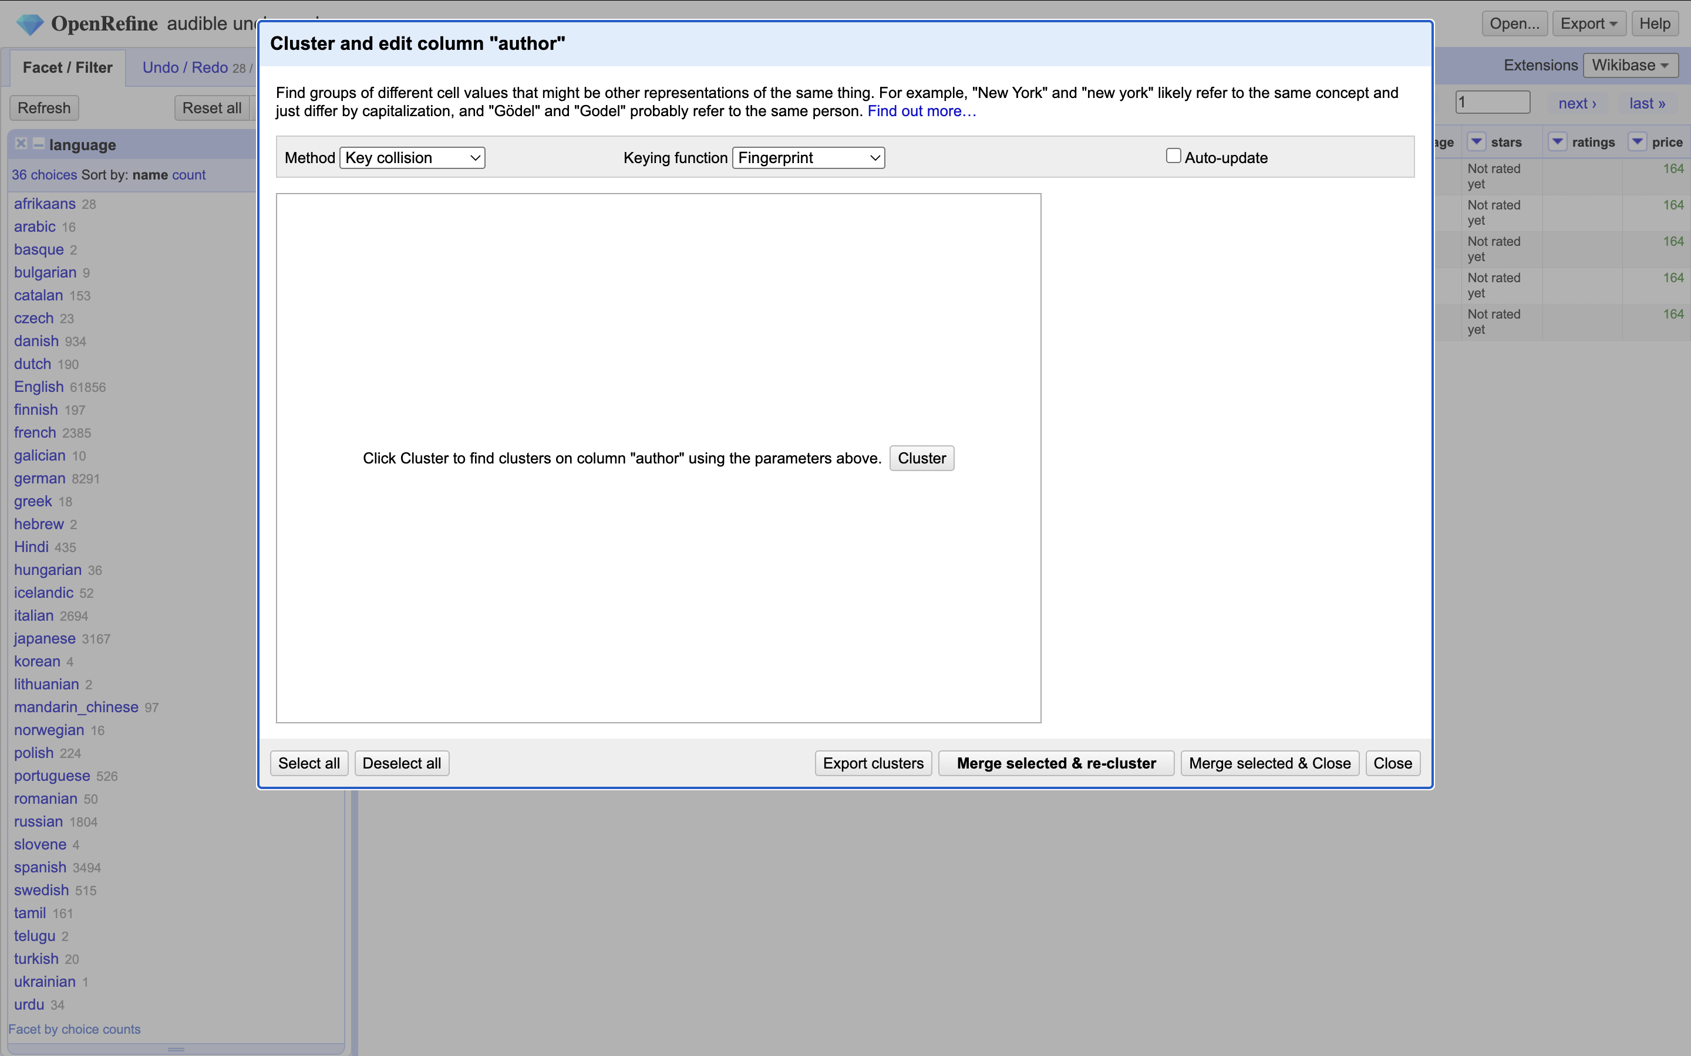
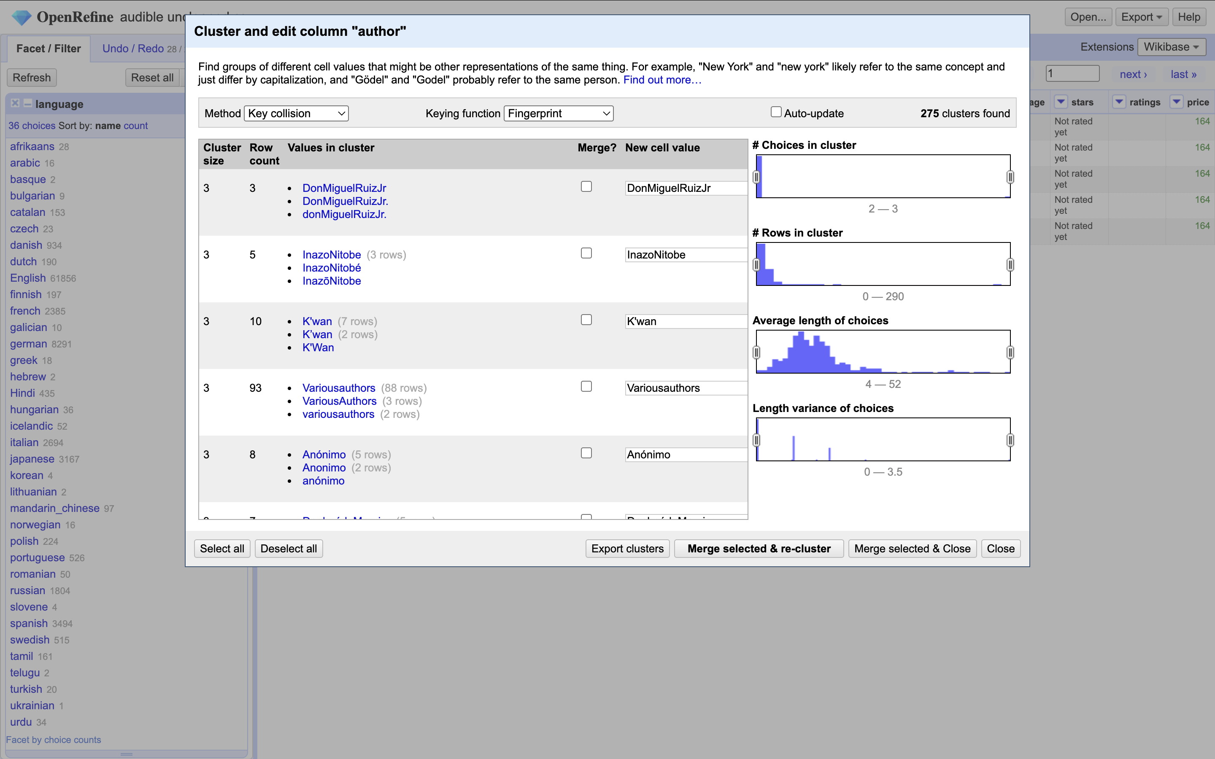
Clustering
Author dropdown -> edit cells -> cluster and edit
Hit cluster
Does some matching to find multiple values that might be the same.
You can then edit and reconcile them to a single value.
Also called disambiguation
REALLY powerful

Slide 29
Homework
Look at the “cleaned” audible dataset we downloaded.
Did they do anything differently than us?

